Slide 1
Презентация внеклассного мероприятия “Легенда о короле Артуре”
Введение.
Цель данной разработки- развитие социокультурной компетенции у учеников. Презентация содержит материал познавательного характера, дающий возможность сопоставления русской и английской культуры , истории и литературы, может быть использован для подготовки внеклассного мероприятия в рамках недели иностранного языка или проведения бинарного урока: английский +история. Презентация имеет практическую направленность.
Обучающая цель- совершенствование лексических навыков, развитие речевых умений- аудирование.
Развивающая- развитие познавательной деятельности, памяти.
Воспитательная- прививать интерес к культуре стран изучаемого языка.
Практическая- улучшить личностные , познавательные УУД.
Narrator: the legend of King Arthur and the knights of the Round Table is the most powerful and enduring in the western world. King Arthur, Guinevere, Sir Lancelot did not really exist, but their names conjure up a romantic image of gallant knights, elegant ladies in medieval castles, heroic quests for the Holy Grail in a world of honour and romance, and the court of Camelot -the center of a royal and mystical Britain.

Slide 2
King Arthur’s Legend
Project, form 9 “A”
Golouykhov Anton & Kovtun Nastya
Teacher: Kozmina S. D.
School №763.

Slide 3
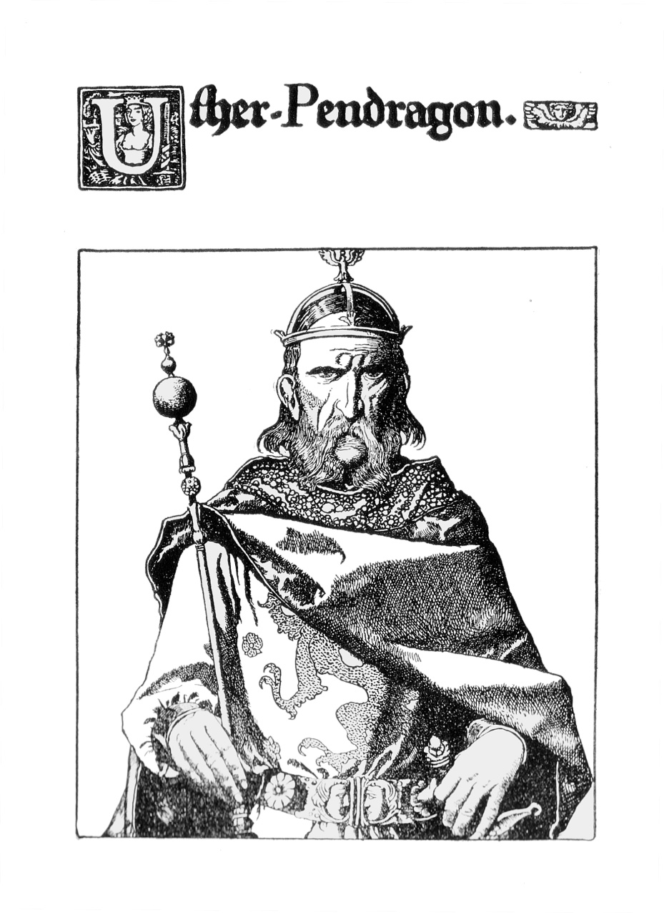
Birth of Arthur
Arthur - son of King Uther Pendragon. Uther was a cruel and terrible king, but he defended his people.

Slide 4
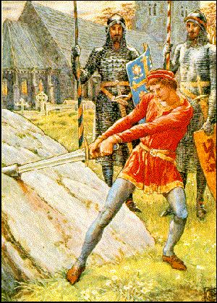
King Arthur becomes king
No one could get a sword. People believed that the first person who got the sword from the rock was to become king of England.
Arthur pulled it out easily and was crowned.

Slide 5
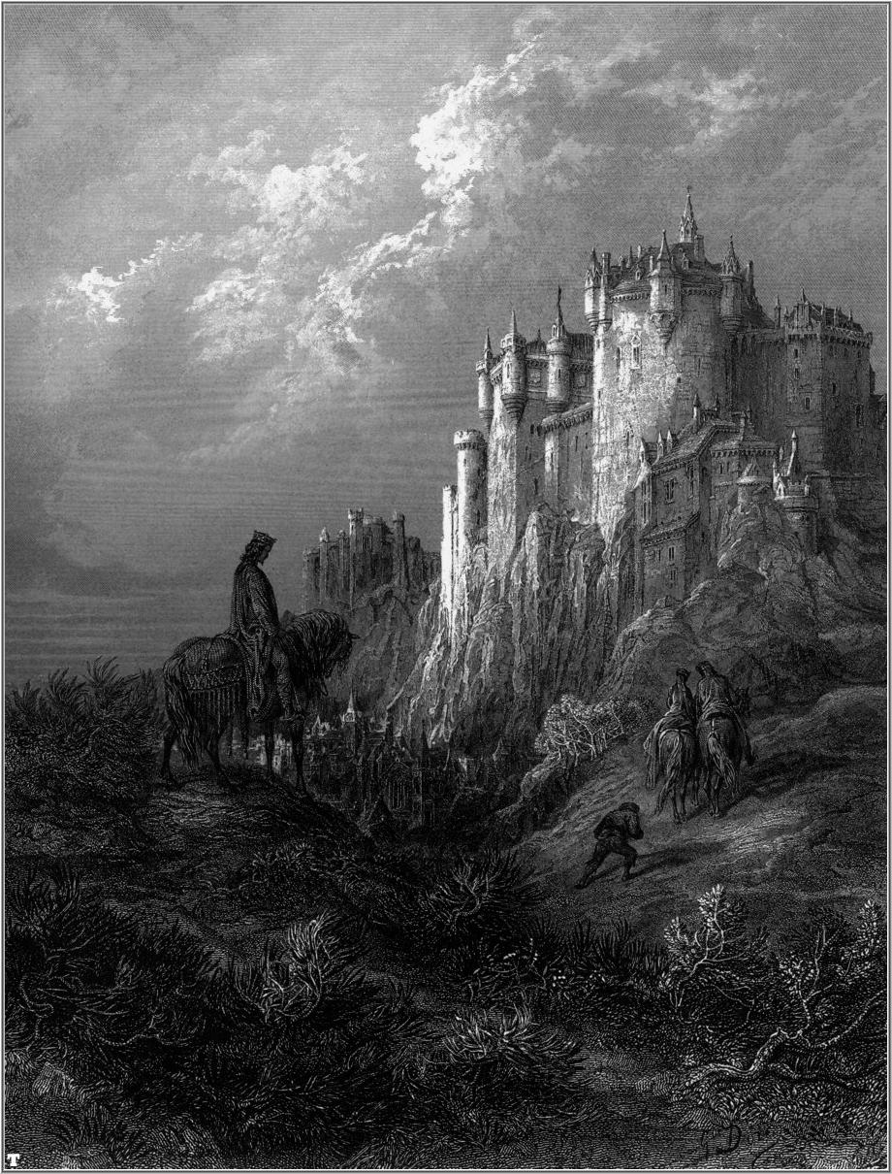
Camelot
Arthur made ​​his capital city of Camelot, and gathered around the table the best knights in the world.

Slide 6
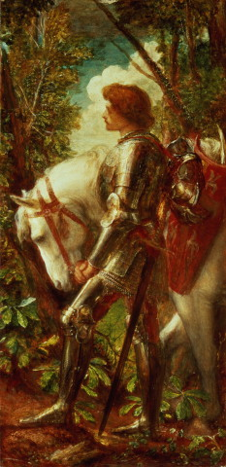
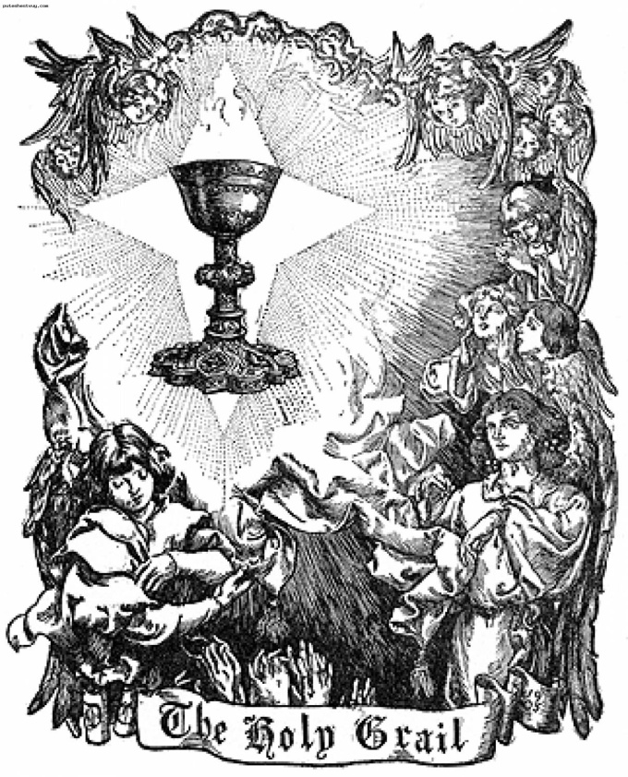
Sir Galahad and Holy Grail
Once a young man in a white robe came to the Round Table. Suddenly, on the empty chair was written Galahad. And all those presents saw the Holy Grail. ( the cup used by Jesus Christ at his last meal) The Knights decided to find it.

Slide 7
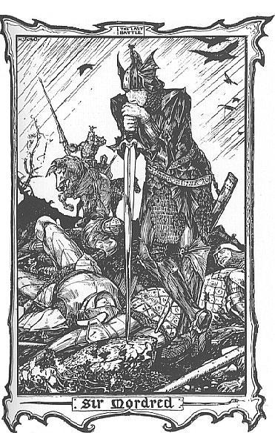
Death of Arthur
Arthur gave power Mordred. But when Arthur arrived overseas, he learned that Mordred had captured Camelot. Arthur hurried back.

Slide 8
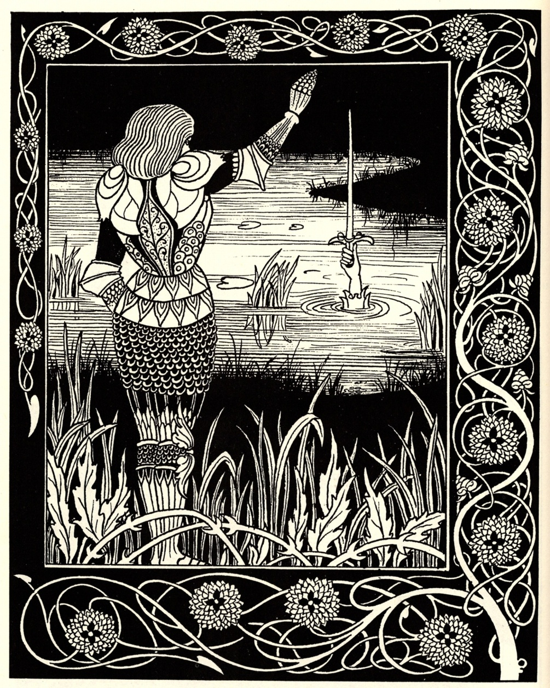
Death of Arthur
The king asked Sir Bedivere to return the sword Excalibur to Lady of the Lake.

Slide 9
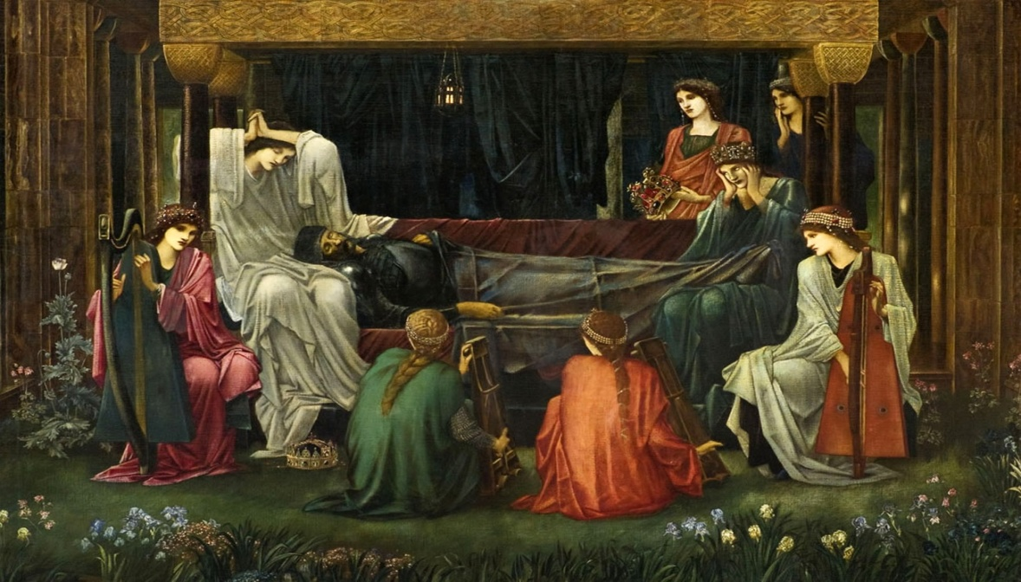
Death of Arthur
Three queens arrived in a boat and took Arthur away to the Isle of Avalon. It is thought that he died there soon afterwards. It is said that Arthur will return if Britain is ever in danger again.

Slide 10
Arthur ,s Legend Quiz

Slide 11
2. What was Excalibur?
King Arthur's crown
King Arthur's horse
King Arthur's sword
King Arthur's dog

Slide 12
3. Who was the magician at King Arthur's Court?
Schmendrick
Merlin
Gandalf
Rincewind

Slide 13
4. Guinevere was King Arthur's ___.
Queen
Sister
Mother
Daughter

Slide 14
10. Which island is said to be the last resting place of King Arthur?
Duat
Valhalla
Avalon
The Elysian Fields

Slide 15
1 What did Arthur throw into the lake? a. his wife b. a magical lady c. his sword 2. Perhaps Arthur didn’t ____________. a. exist b. die c. win 3. There is no __________ of his existence. a. book b. proof c. story 4. Arthur’s story has been told for _________ of years. a. hundreds b. thousands c. millions

Slide 16
When Arthur was a boy, he pulled the (1)________ from the (2)__________ and became king. The story of Arthur is about (3)__________ and (4)_________. He fought against (5)________ and went into battle against his (6)__________. In the final battle he was (7)__________. He (8)__________ his sword into a lake so that the Lady of the Lake could (9)__________ it, then died. However, perhaps it is just a story. Maybe he did not (10)__________.
5 bravery, the forcers of evil ,exist, look after, half-sister,nobility, stone, sword, threw, hurt

Slide 17
Listening “King Arthur”
№2.
Yesterday, Martin read 3. When Arthur was young,
A. A legend about king . A.He fond a stone.
B A story about knights. B.He believed in a great king.
C. A book about battles. C.He didn’t know he was king.
2. Camelot was beautiful 4.Excalibur helped Arthur
Knight. A. To get out of the rock.
B. Castle. B. Fight against the knights
C. Sword. of the Round table.
C. To win difficult battles.

Slide 18
Приложение Текст для аудирования

