Slide 1
Articles
the
a/an
zero article

Slide 2
Definite article the
We use The :
when we talk about a unique subject
The sun shines brightly.
when it is something we talk about before
I bought a book yesterday. The book is about London.
when the noun preceded by superlative adj. or ordinal numerals
He is the best student in the fifth class
with geographical features
The most famous river in Britain is the Thames.
with historical period
The Roman Empire was one of the most successful empires in world history.
with expressions
in the morning/evening, on the one/other hand, on the right/left, the kitchen/the living room…

Slide 3
Indefinite article a/an
We use a/an
When we talk about something for the first time
I bought a new car
when we talk about one of many
a woman I know spends a lot of money on clothes
If we talk about particular type of person or thing
a designer suit is expensive
with jobs
I’m a teacher
with single units of distance, time, weight, money, fractions
a mile, an hour, a kilo, a cent, a euro, a third, an eight
with the words rather, quite, such
It’s a rather difficult question
with expressions
in a hurry, as a result, to have a good time

Slide 4
We don’t use an article with
When we talk about tings in general
Modals are usually tall and slim.
With abstract nouns
There is no justice in the world!
Music makes me calm.
With countries, continents, languages
In Europe, in Asia, in France, In London, Spanish, Russian…
With days and months
See you on Monday. I’m going to Greece in June.
With meals
What do we have for dinner?
With the words
school, church, hospital, university, prison … and other institutions
With expressions
By chance, by mistake, in fact, in case of

Slide 5
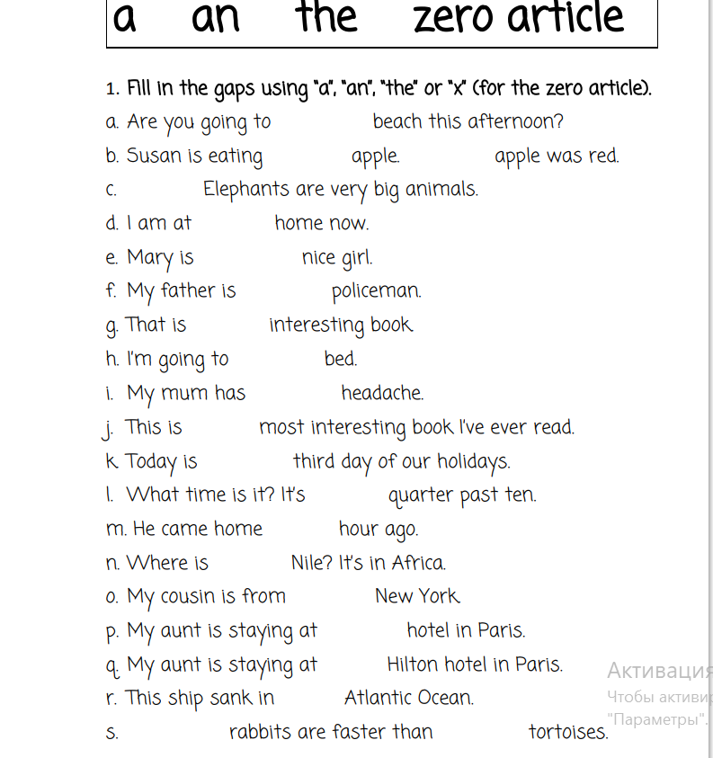
Let’s practice!
the
an
The
X
X
a
a
an
X
a
the
the
a
an
the
X
a
The
The
X
X

