Slide 1
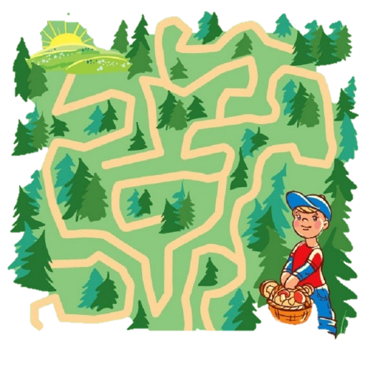
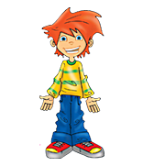
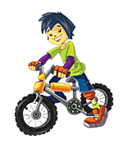
Quest in the Magic Forest

Slide 2
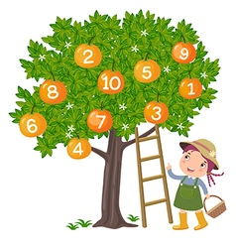
“1,2- How do you do?
3,4 –Who’s at the door?
5,6 –My name is Alex.
7,8 –Don’t be late.
9,10–Say it again”

Slide 3
“This is Lee
and that is Jill.
This is Harry
and that is Bill.
This is Missy
and that is Mona.
This is Emma
and that is Conan.

Slide 4
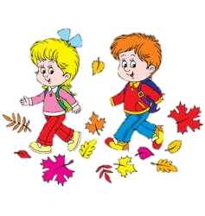
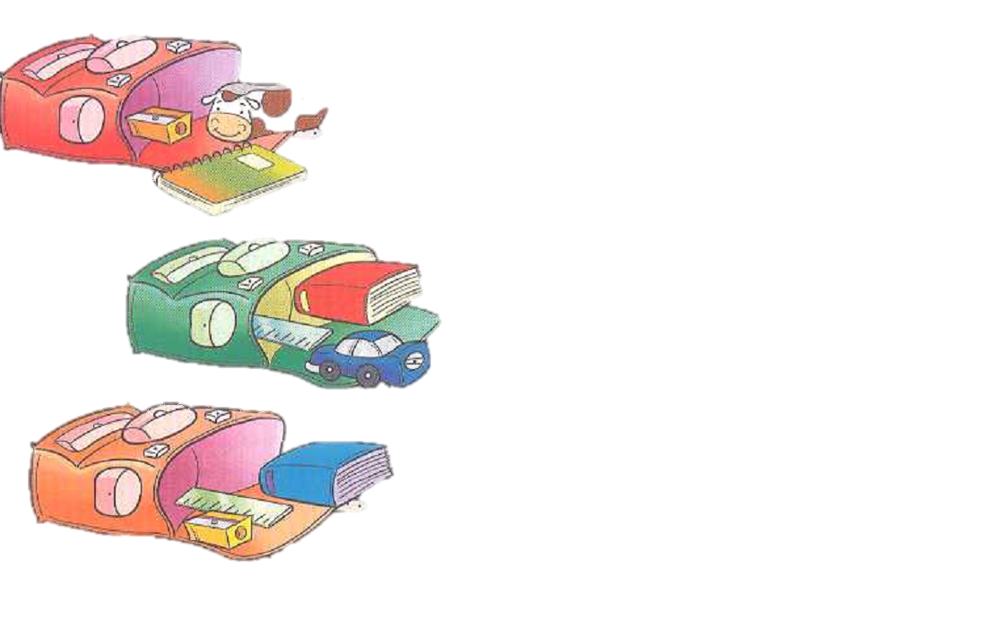
Let’s Sing
What’s in your schoolbag?

Slide 5
It’s got four sides –
they’re all the same”(twice) –
it’s a square.
It hasn’t got sides –
it’s smooth and round”(twice) –
it’s a circle.
It’s got four sides-
two long , two short”(twice)-
it’s a rectangle.
It’s got three sides-
just one, two, three”(twice) –
it’s a triangle.”

Slide 6
-What’s this/that ?
– It’s a sharpener.
-Whose is the sharpener?
– I don’t know.
–What colour is it?
- It’s green.
–What shape is it?
- It’s square.
– I know. It’s Katya’s sharpener.
–Thank you

Slide 7
this/that
-What’s _________?
– It’s a _________.
-Whose ______________?
– I don’t ____ .
–_____ colour is __?
- It’s _____.
–What _____ is it?
- ___square.
– I know. ___Katya’s _________.
–Thank ___.
sharpener
is the sharpener
know
What
it
green
shape
It’s
It’s
sharpener
you
you

Slide 8
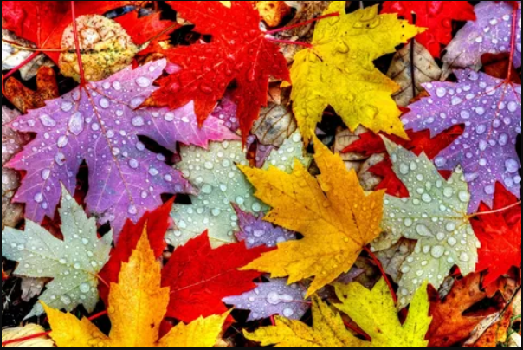

Slide 10
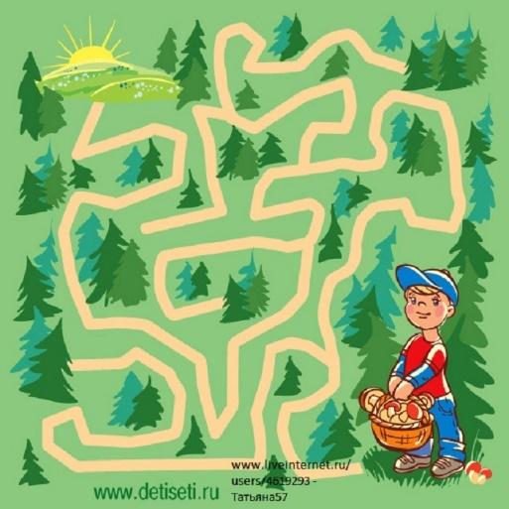
Quest in the Magic Forest

